Slide 1
Course 3 Fundamentals of transport planning and management
Dr Eng. Lech Michalski, prof. GUT
Highway Engineering ant Transport Department
Poland

Slide 2
Objectives
to familiarizes students with main goals and components of transportation systems
to acquire some basic knowledge on organizational structure, methods and procedures used in transport planning and finally on the role of ITS in transport system
and….

Slide 3
to give knowledge of planning measures how to meet such challenges as
:
Sufficient space for cars
Integration of all transport modes
Save are attractive areas for pedestrians
Less separation caused by traffic
Strict adherence to threshold values of pollutants
Promotion of cycling
Priority for PT
Traffic safety
Safe ways to school
(Drawing: DIETIKER, LOOSER; in: SELLE 1996)

Slide 4
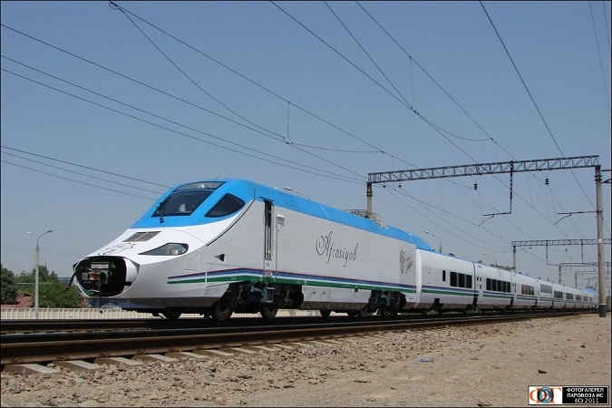
Contents
Urban transport planning
Intermodal integration planning
Accessibility and mobility planning
Transportation impacts
ITS Planning approach
Fundamentals of transport systems
Transport planning processes
Transport policy and multi-modal transport studies
Surveying and modelling in transport planning

Slide 5
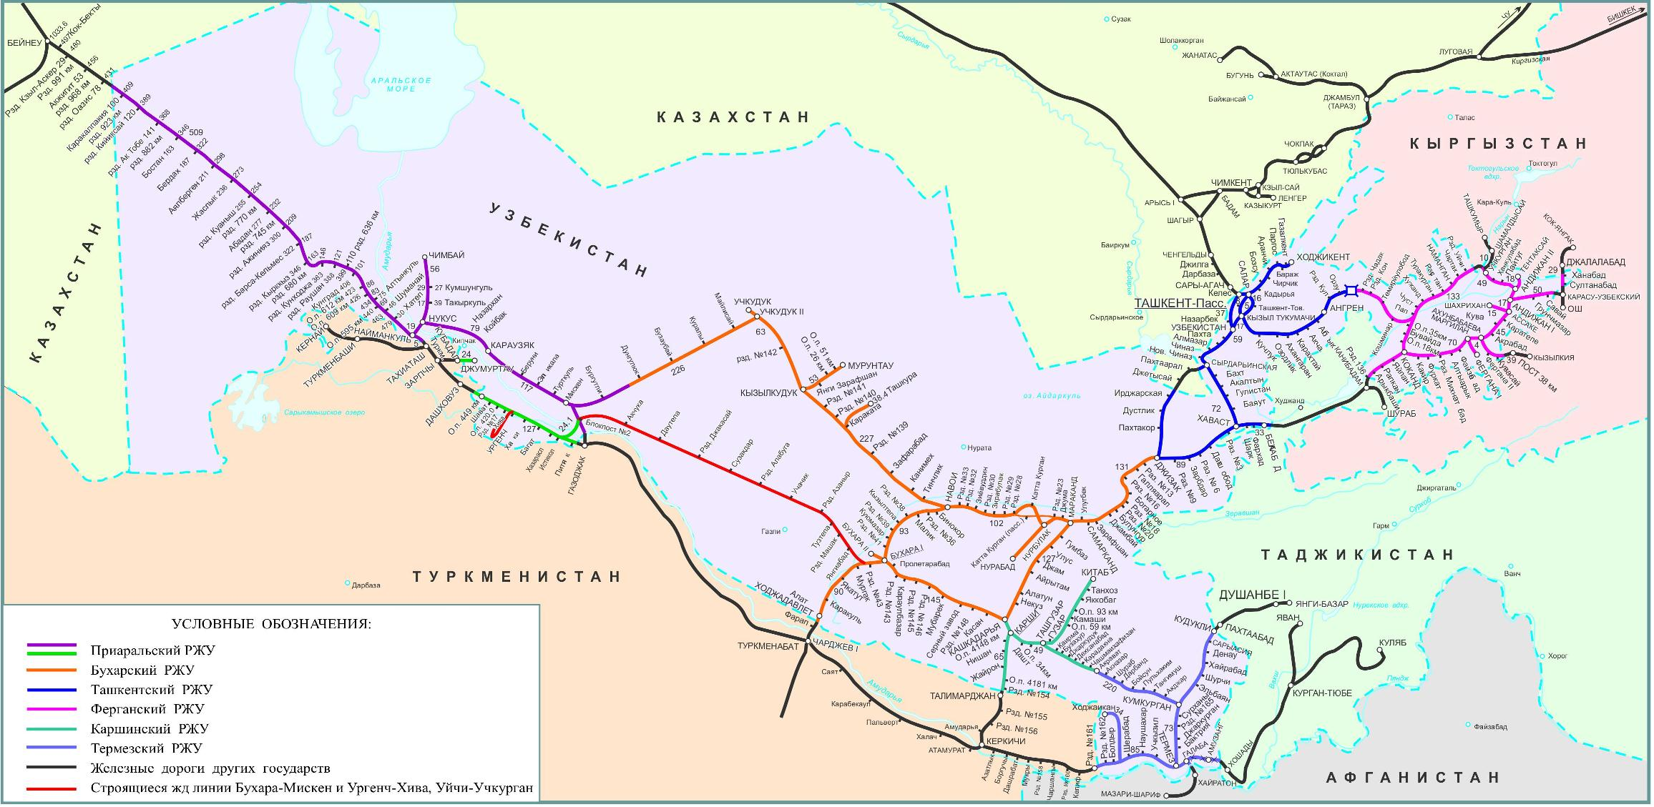
1. Fundamentals of transport systems
Transport network
Transport system components
Transport modes and terminals
Transport system in Uzbekistan
Transport system key issues

Slide 6
Transport network

Slide 7
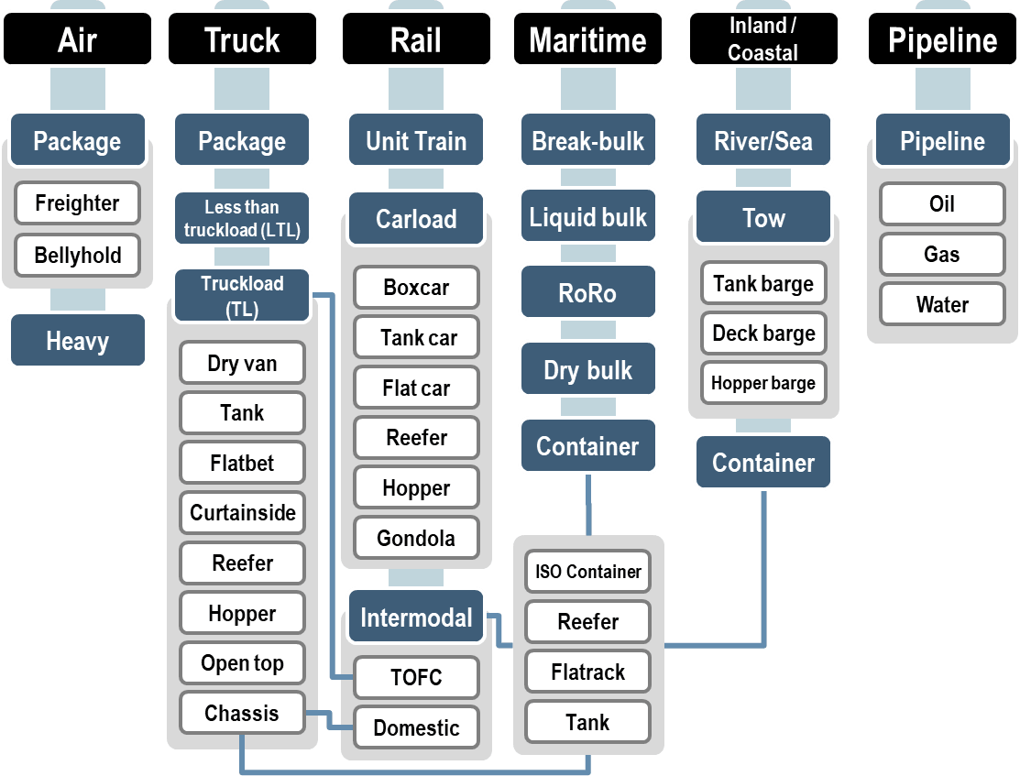
Transport modes
Passenger Modal Options
Freight Modal Options

Slide 8
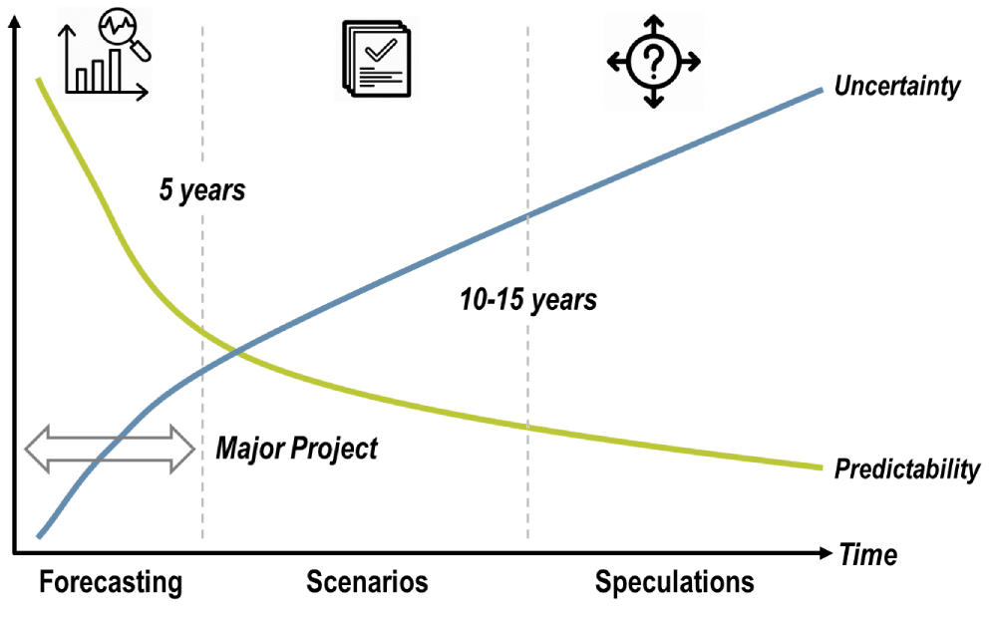
Transport system planning key issues
Definitions (planning, network, transport systems, ……)
The Prediction of Future Outcomes

Slide 9
2. Transport planning processes
Formal transport planning procedures on national, regional and local level
Planning acts in Uzbekistan - existing and expected situation
From the old to the new logic in transport planning
Planning steps (diagnosis and evaluation, goals and concepts, decision making, implementation and monitoring)
Integration of transport and land use planning

Slide 10
Transport planning process features
iteractive, stepwise process
requires the inputs of many specialists
helps shape a well-balanced transport system that can meet future demands
helps develop needed projects to satisfy future demands

Slide 11
Steps of planning process
defining goals and objectives based on public opinion and a regional vision for the transporttion system
inventory of existing conditions such as land use, transport facilities and their usage, travel patterns nad resources.
analysis using analytical relationship or tranportation models to identify deficiencies and needs
identification of short and long range solution strategies or projects

Slide 12
From the old to the new logic
Old Logic | Feature | New Logic
expand | networks | Manage and integrate
Predict and provide | forecasts | Predict and manage
Hard – supply oriented | technology | Soft – demand oriented
Engineers | Professional culture | Managers open
Hermetic and sectoral | Policy making | Discourse and Integration
Reduce travel time | time | Niche, certainty
Homogenous | space | Customised
Site specific externality | enviroment | Global emissions
Dis-engaged | users | Re-engaged
Macro extrapolation | modelling | Micro level responsive
Standardised, static | Knowledge and information | Tailored dynamic

Slide 13
3. Transport policy and multi-modal transport studies
Transport policy
Transport strategies (top-down approach)
Transport plans (bottom-up approach)
Governance in transportation
Notes:
.

Slide 14
Transport policy formulation and implementation
Transport Planning
Policy Formulation
Planning process
Goals of policy formulation
Problem analysis
Development of scenarios
etc.
Implementation
Realisation of defined measures / plans
Paying attention to social & political acceptability
Quality control
etc.
Tools for Policy Formulation
Tools for Implementation
Scenario technique
Participation process
Awareness raising
Participation process
Awareness raising
Project management
etc.
Project management
etc.
Source: BOKU-ITS; adapted by RVS 2.1, 1984

Slide 15
Measures/instruments of transport policy
Investment & Services
Transport infrastructure network
Co-ordination of different transport modes
Transport system operation
Rationalisation of PT
etc.
Planning
Improvement of the PT network
Combination of environmentally friendly transport modes
Co-ordination of transport planning with urban development
etc.
Information & Information Policies
Information & awareness campaigns
Mobility management
etc.
Regulation
Access restrictions for motorised traffic
Parking space management
Parking licenses linked to car ownership
Speed limits
Traffic calming
Vehicle manufacturing & emission standards
Pricing
Subsidies
Restrictive pricing policies – vehicle tax, fuel tax, parking charges, road pricing, impact fees
etc.
Notes:
.

Slide 16
4. Surveying and modelling in transport planning
Data availability and travel surveys
Transport models for planning
4 step travel-demand forecasting model
Scheduled service model
Software availability and specialist modelling knowledge

Slide 17
Four-Stages Transportation / Land Use Model
Trip Generation
Trip Distribution
Land Use Data
Travel Generation Factors
Friction of Distance Factors
Calibration Factors
Transportation Networks
Feedback
Modal Split
Traffic Assignment

Slide 18
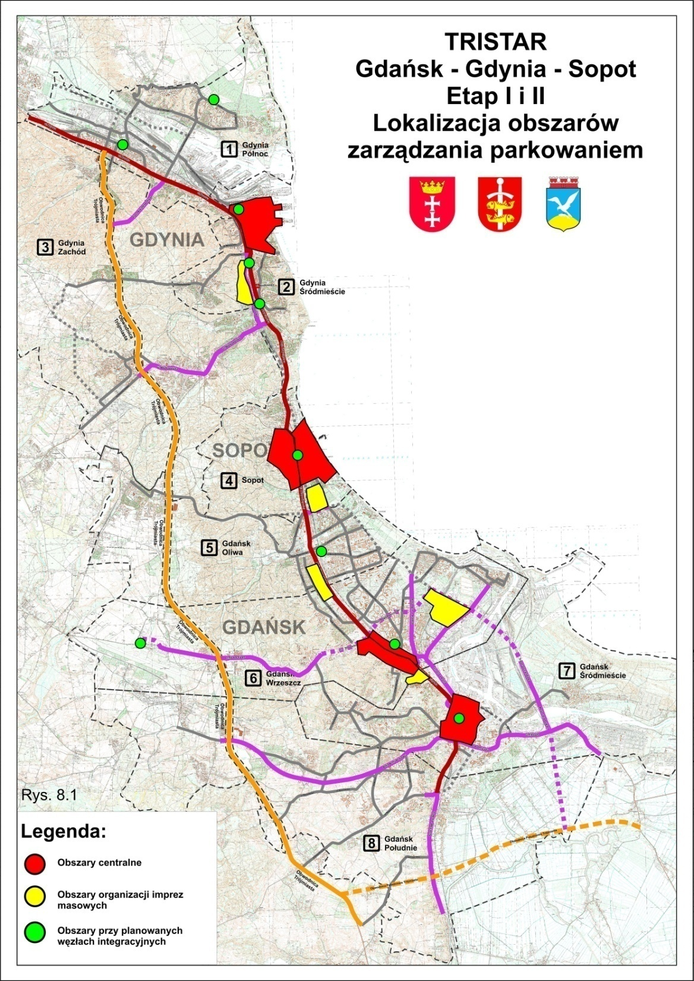
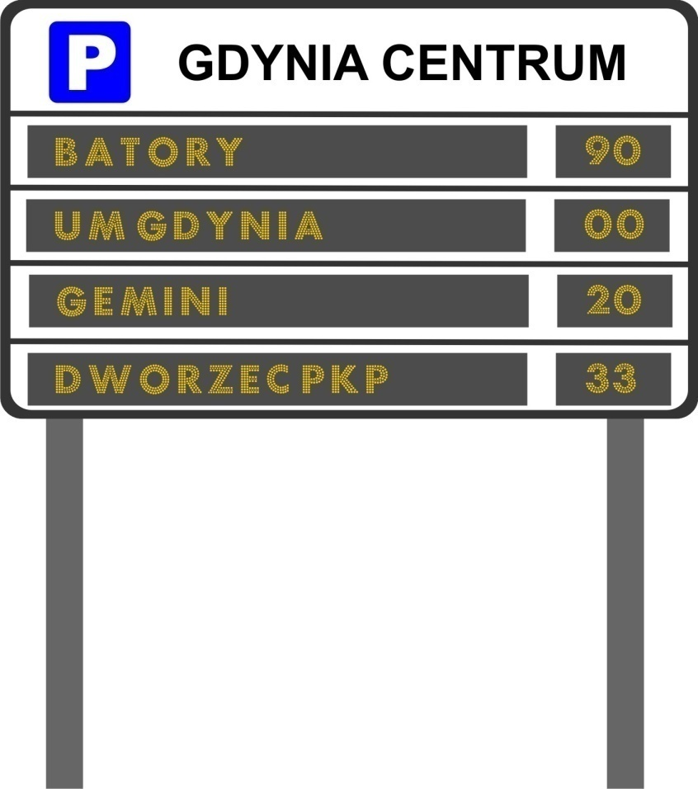
5. Urban transport planning
Public transport system planning (lines, networks, stations, terminals)
Walking and cycling system planning
Parking system planning
Information system planning

Slide 19
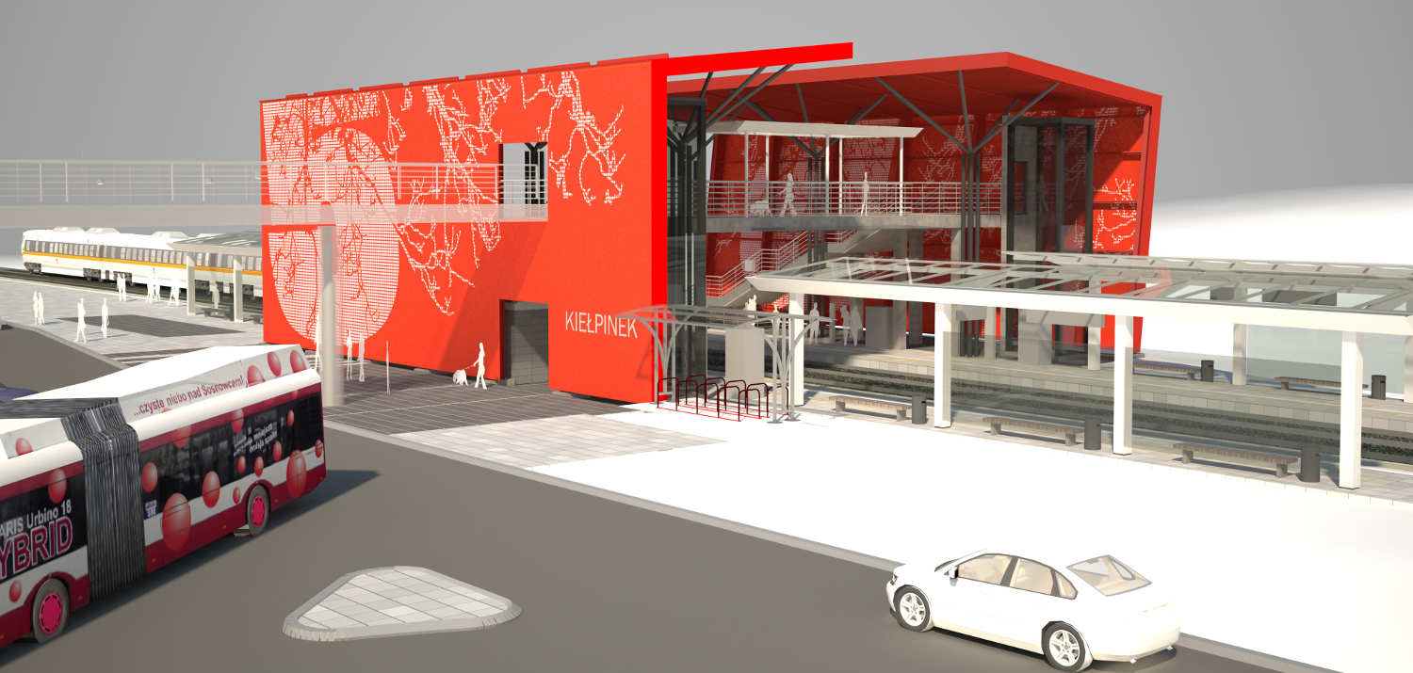
6. Intermodal integration planning
Principles of transport integration
Barriers to intermodal integration
Passenger interchange supplies and quality
Freight interchange supplies and quality

Slide 20
Principles of transport integration
Strong relationship between planning for transport, land use and other areas, such as economic development, education and health
Across sectors, levels of planning, locations and decision makers
Taking into account direction, knowledge and priorities from other levels of planning (top down and bottom up)
Considering planning choices as a total package, rather than considering them in isolation

Slide 21
Horizontal and vertical integration

Slide 22
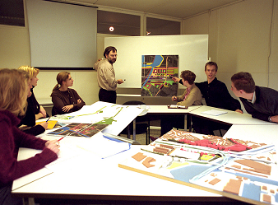
7. Accessibility and mobillity planning
Accessibility versus mobility
Travel demand management
Mobility management

Slide 23
Mobility management
Mobility Management is primarily a demand-oriented approach to passenger and freight transport that involves new partnerships and a set of tools to support and encourage a change of attitude and behaviour towards sustainable modes of transport.
These tools are usually based on information and organisation, co-ordination and require promotion.

Slide 24
Objectives of mobility management
to encourage a change of attitude and behaviour towards greater use of sustainable transport modes, i. e. public transport, collective transport, walking, cycling and intermodal combinations
to improve (sustainable) access for all people and organisations by strengthening the conditions for sustainable modes
to satisfy mobility needs via a more efficient and integrated use of (existing) transport and land use infrastructure

Slide 25
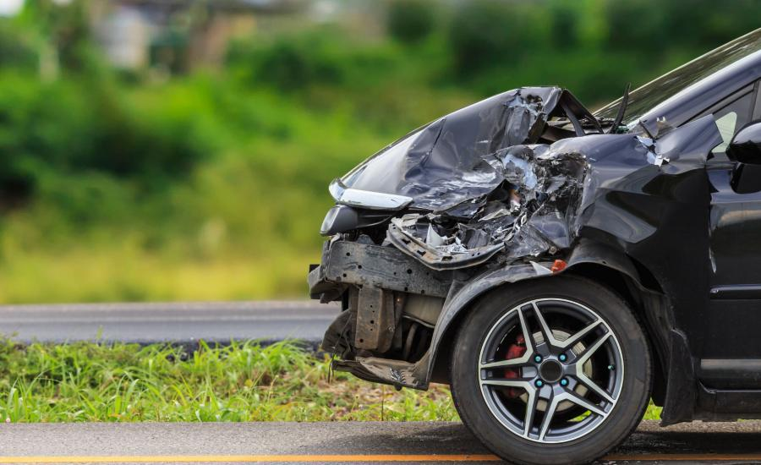
8. Transportation impacts
Transport safety and security planning
Sustainability in transport planning
Territorial development evaluation
Economic analysis

Slide 26
Sustainability in transport planning
What is sustainability and sustainable transportation
City of the future
Principles of street design
Pedestrians, bicycles, public transport on planning stage
Carsharing
Stations and station areas

Slide 27
Safety management
safety strategy
measures at high
risk sites
enforcement
measures to help
pedestrians and cyclists
education, training
and publicity
area safety
schemes
environment
health, welfare and
education
road construction
and maintenance
public transport
land use
other policies influencing safety

Slide 28
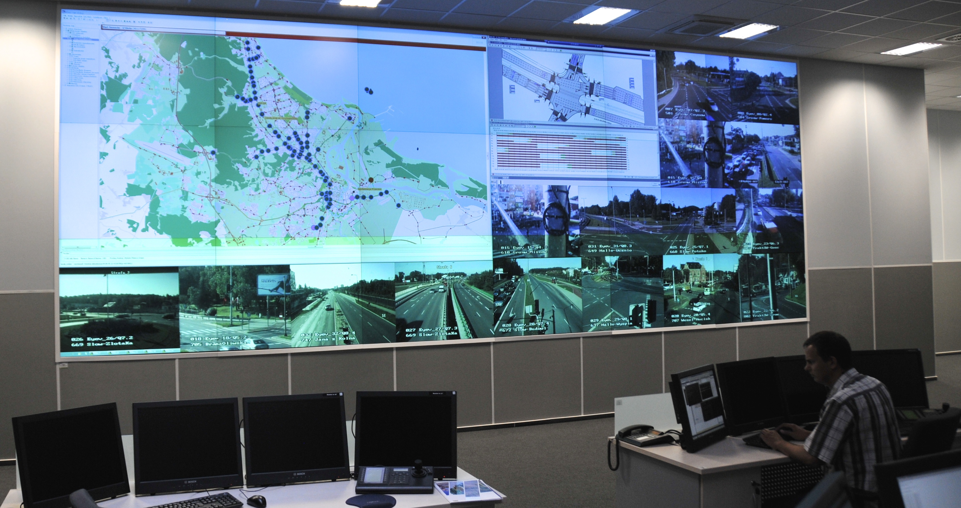
9. ITS Planning approach
Key questions
Conventional vs ITS planning approach
Alternatives for ITS planning
Information Technologies and Mobility
Case studies

Slide 29
Key questions
What is difference between traditional transportation planning and ITS planning?
What role can a metropolitan planning organisation play in ITS planning?
What are the advantages of traceability-based ITS planning?
How could the national ITS architecture be used as a resource in ITS planning?
How can ITS planning be integrated with the transportation planning process?

Slide 30
Alternatives for ITS planning
Market package-based ITS planning process
Traceability-based ITS planning process (engineering top-down approach)
Vision
Function
Potencial projects provide the required functionality
Objective

Slide 31
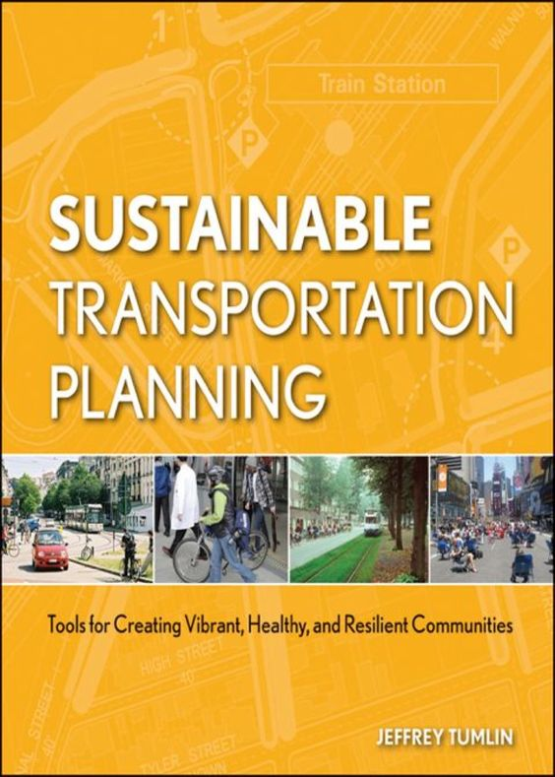
Teaching and assessment methods
Lectures,
case studies,
tutorials/exercises
Mid-term and final oral and/or written examination,
exercises from case studies.

Slide 32
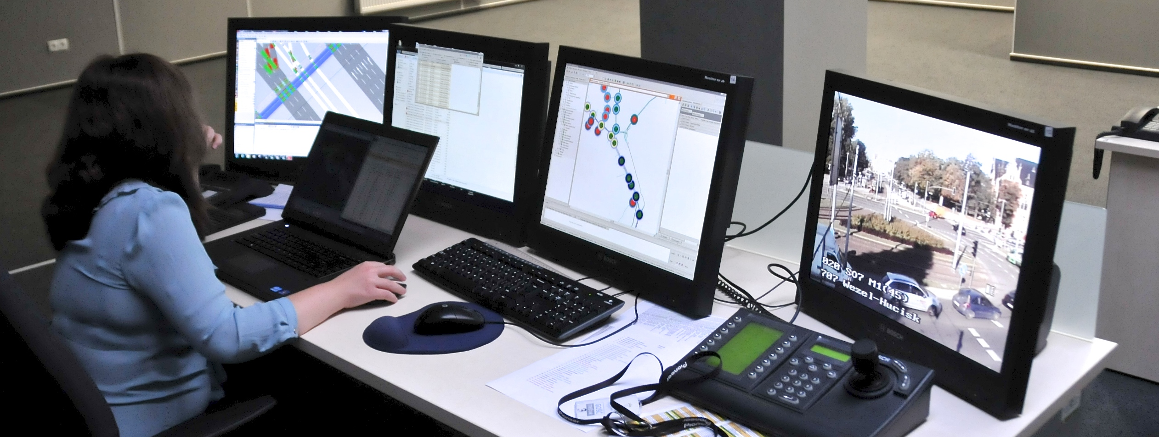
Laboratory
Travel matrix calculation for small urban area (Vissum)
Road (street) or public transport network replanning
Designing of mobility plan for company, school
Software
VISUM - Travel Demand Modelling
others

Slide 33
Textbooks and Publications
Integrated transport planning framework - A guide for transport planning. Queensland Government, september 2003
Todd Litman (2008), Comprehensive Transport Planning: Best Practices For Evaluating All Options And Impacts, VTPI (www.vtpi.org); FHWA and FTA (2007), The Transportation Planning Process Key Issues: A Briefing Book for Transportation Decisionmakers, Officials, and Staff, FHWA-HEP-07-039,
Integrated Transport Planning Framework. A Guide for Transport Planning, Queensland Gov. 2003

Slide 34
Thank you for your attention

